Slide 1
Cell Organelles: Microfilaments, Microtubules, Nucleus, The Cell Cycle
Lecture 16

Slide 2
Objectives
Define the term cytoskeleton
Describe the structure & functions of microfilaments, intermediate filaments, and microtubules
Describe the structure (anatomy), contents and functions of the nucleus
Define the term cell cycle and describe briefly its different phases
Match individual functions/events of the cell cycle with the phase in which such functions/events occur

Slide 3
Cytoskeleton
cyto "cell," skeleton "skeleton"
an elaborate network of "rods" running through the cytosol and hundreds of accessory proteins that link these rods to other cell structures
acts as cell’s “bones,” “muscles,” and “ligaments” by supporting cellular structures and providing machinery to generate various cell movements
three types of rods in the cytoskeleton:
microfilaments
intermediate filaments (seen earlier with desmosomes)
microtubules

Slide 4
Microfilaments
Thinnest elements of the cytoskeletal elements
7 nm diameter
Semiflexible polymeric strands composed of actin monomers: G-actin assembled into F-actin
G-actin: globular [monomeric] actin
F-actin: filamentous [polymeric] actin
Each cell has its own unique arrangement of microfilaments, so no two cells are alike
Terminal web: fairly dense cross-linked network of microfilaments making up the cell cortex
Cell cortex is shell-like layer under the plasma membrane
Microfilaments assemble and disassemble dynamically, having a polarity (plus and minus end)

Slide 5
Microfilament / Cell Cortex Function
Microfilaments provide the cell cortex with ability to:
be rigid: strengthening the cell surface, allowing cell to resist being compressed
facilitate shape changes to cell when needed
transmits force during cellular movements; locomotion
Actin in microfilaments interact with protein unconventional myosin to cause contraction that leads to cell shape changes which include forming pseudopodia in phagocytosis and in cell crawling
cells move “when they get their actin together”
During cell division, microfilaments form a contractile ring around the cleavage furrow that pinches one cell into two during cell division

Slide 6
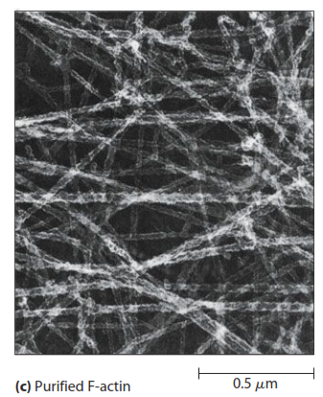
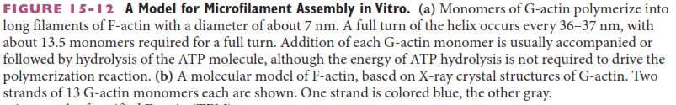
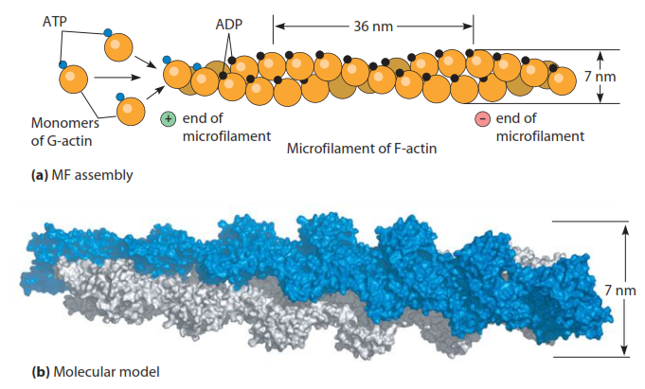

Slide 7
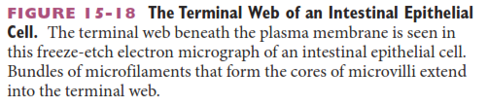
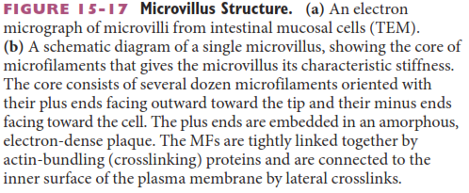
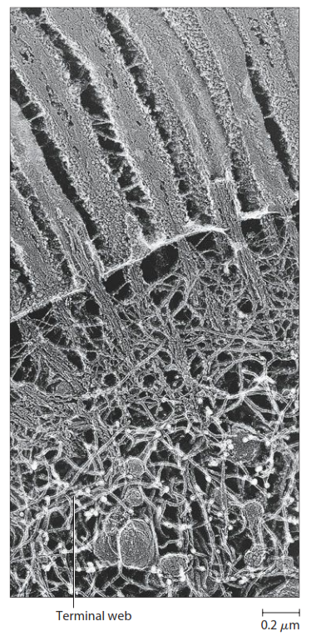
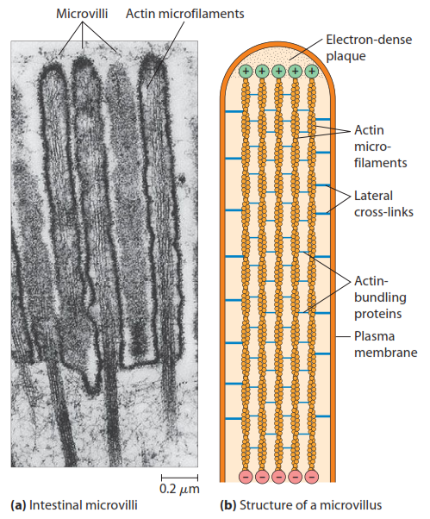
microfilaments are responsible for giving microvilli their structure on intestinal mucosal cells
The terminal web is shown at far left

Slide 8
Intermediate Filaments
Structure (proposed model)
Diameter (8-12 nm) is "intermediate" between microfilaments and microtubules, hence the name
Tough, insoluble protein fibers that resemble woven ropes
Organization (see diagram next slide)
Dimer formation: two polypeptides form knotted 2° and 3° structural on the N- and C-terminal ends, with paired twisting long axes in polypeptide middle sequences
Tetramer formation: two dimers then form staggered interaction to form a tetramer
Protofilament formation: the staggered tetramers join end-on-end to form the protofilament
Final IF formation: 8 protofilaments assemble together

Slide 9
Intermediate Filaments
Composition & Function
The proposed function of intermediate filaments (IFs) is to provide strength against mechanical stress or force the cell may be subjected to
Structures identified as IFs interestingly have different composition and provide various functions
IFs composed of keratins connect with desmosomes in epidermal (skin) cells
IFs composed of lamins bind to nuclear inner membrane and pores to help nucleus keeps its structure and to form the envelope

Slide 10
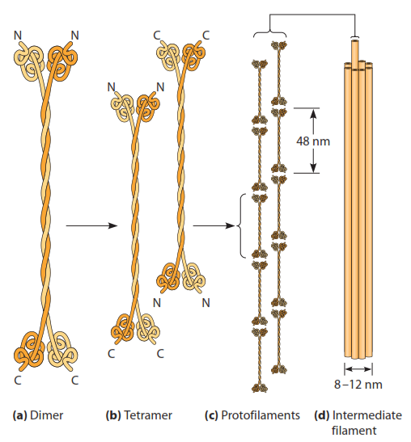
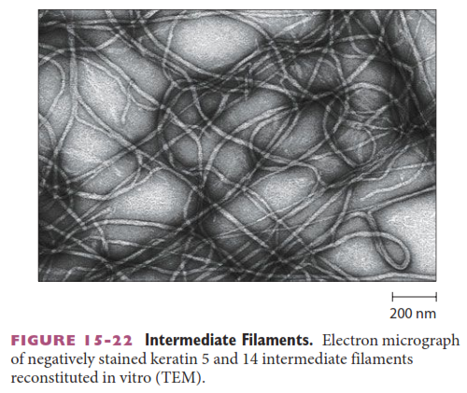
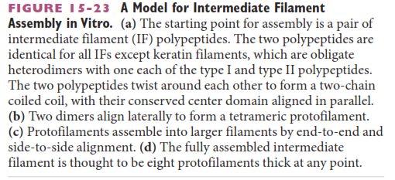

Slide 11
Microtubules
Structure / Composition
Hollow tubes having the largest diameter of all rod-like cytoskeletal filaments
Composed of protein subunits alpha- and beta-tubulin
subunits are 55 kDa and have 40% amino acid sequence identity
Microtubules are dynamic and have polarity
they assemble (grow) on one end, the plus (+) end
they disassemble ("ungrow") on the other end, the minus (–) end
this dynamic assembling/disassembling called treadmilling
Microtubules radiate from the centrosome, located near nucleus

Slide 12
Microtubules
Functions
Microtubules are stiff and flexible & can affect cell shape and the location of organelles in the cell
Microtubules also provide a path along which organelles (mitochondria) and vesicles (lysosomes, secretory vesicles) can move to a cellular location
Protein complexes (e.g. dynactin) have special proteins (kinesins, dyneins, etc) that attach to microtubules and to vesicle or organelles together, utilizing ATP energy to change conformation to create a sliding movement to reposition organelles and vesicles

Slide 13
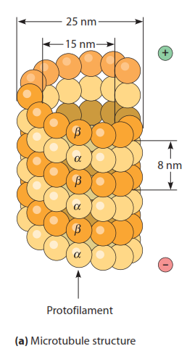
The general feature of a microtubule
spiraling (helical) alternating polymers of two proteins, alpha (α)-tubulin and beta (β)-tubulin create the rod-like structure
protofilaments are copolymeric α - and β -tubulin assemblies that interact along the axis
MT is hollow in the center, with a 25 nm outside diameter and a 15 nm hollow inside diameter
~13 protofilaments form the hollow tube that is the MT
Microtubules ASSEMBLE (grow) from the + end, adding tubulin monomers
Microtubules DISASSEMBLE from the – end, monomers falling off

Slide 14
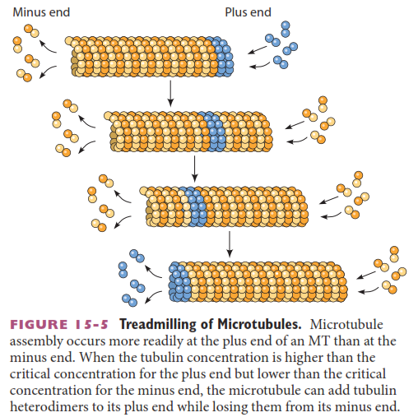
dynamic assembly and disassembly of microtubules (treadmilling)
α- and β-tubulin dimers (pairs) are added to + end that extends the tubule
pairs come off the MT at the – end

Slide 15
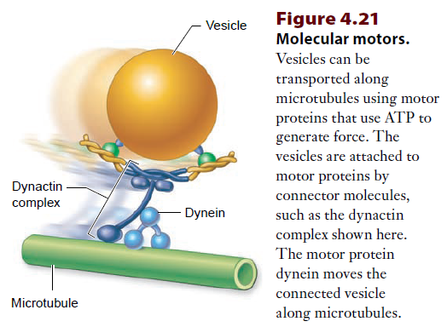
Microtubules form "railroad tracks" along which typically secretory vesicles can move to a final destination
The vesicles attach to protein complexes like dynactin which contain proteins like dynein that use ATP to make conformational changes (twists & turns) while grabbing microtubules

Slide 16

Dynein Motor Movement

Slide 17
Centrosome & Centrioles
A centrosome is located usually on the periphery of the nucleus: it consists of two centrioles oriented at right angles to each other
Centrioles consist of a pinwheel array of nine sets of microtubules fused in a triplet formation, the fusion enabled by non-tubulin proteins
Centrioles also form the bases of cilia and flagella
The centrosome is a microtubule organizing center (MTOC)
These microtubules may radiate all over the cell to affect shape
In mitosis, centrioles separate and move to opposite poles of the cell, extending microtubules to form spindles to each centriole: chromosomes will separate and be moved along the spindle array of microtubules to the opposite poles

Slide 18
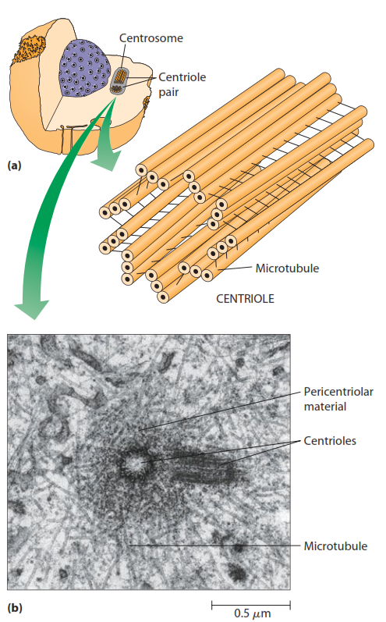
Centrosome consists of two centrioles oriented at right angles
Each centriole has 9 sets of microtubules fused in a triplet formation, with a pinwheel like arrangment
Microtubules grow out of the centriole, and particularly during mitosis when they form spindles that separate and move chromosomes

Slide 19
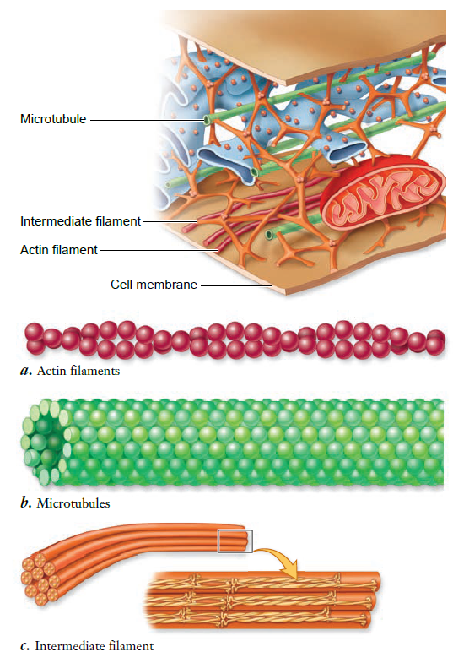
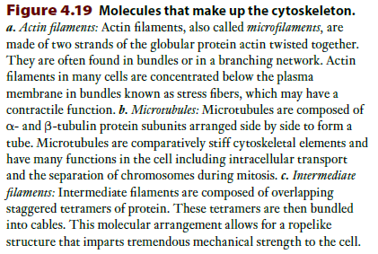

Slide 20
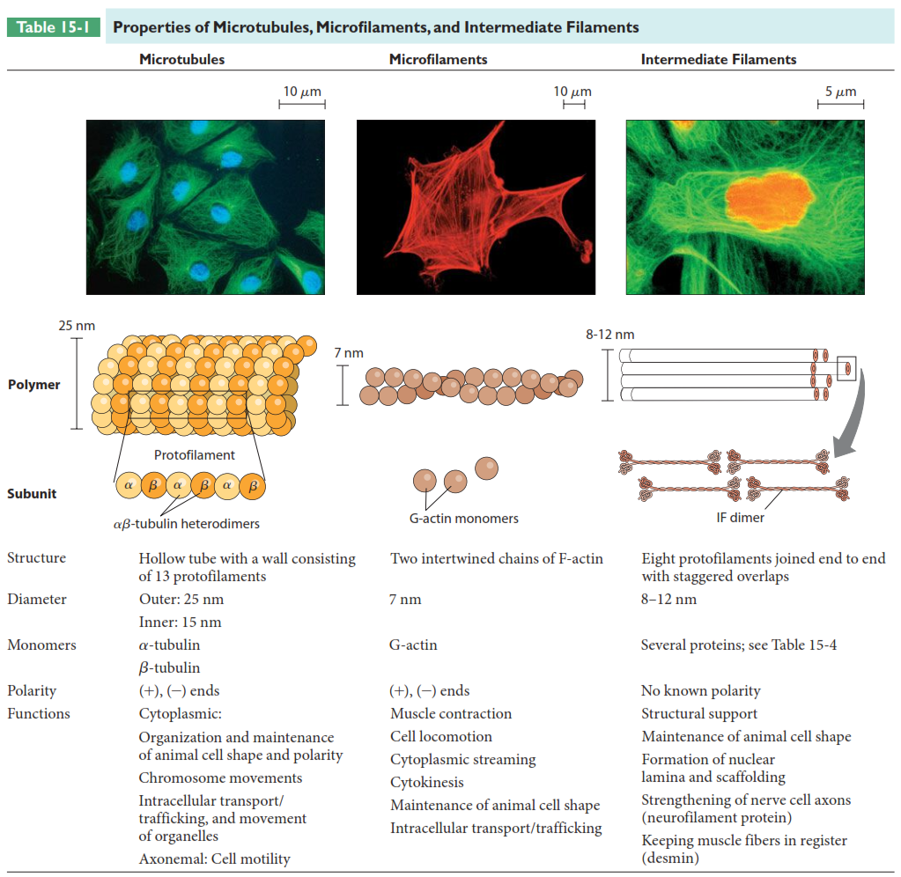
Comparison of features of structure & function of microtubules, microfilaments, and intermediate filaments

Slide 21
Nucleus
Structure & Composition
Generally 5 μm diameter of spherical or ellipsoidal shape
Largest of the cell's organelles
Can represent almost the entire volume of the cell, particularly when the cell is actively proliferating and not differentiated to do its function
stem or progenitor cells
Three recognizable regions or structures under a microscope
nuclear envelope (membrane)
nucleoli
chromatin

Slide 22
Nuclear Envelope
a double-membrane structure that segregates the nucleus contents (nucleoplasm) from cytoplasm
the double membrane
inner membrane
outer membrane
A 20-40 nm perinuclear space separates the inner & outer membrane
Nuclear envelope is continuous with the rough ER (RER) and thought to be derived from it
The ER cisternal space continuous with perinuclear space
ribosomes are formed in nucleolus of nucleus
Nuclear envelope is penetrated by many nuclear pores which are portals between nucleus and cytoplasm

Slide 23
Nuclear Pores
Channels providing direct contact between cytoplasm and nucleoplasm
Each pore is made by fusion of the two membranes of the nuclear envelope, strengthened by an annulus
annulus = octameric protein, located on cytoplasmic and nucleoplasmic sides
Most nuclear envelopes have pore density of 10-12 pores/μm², or 3000-4000 pores per nucleus
Pores have 9 nm diameter, covering 2%-25% of surface area of nucleus

Slide 24
Nuclear Cortex
also called nuclear lamina and karyoskeleton
composed of network of intermediate filaments, of a type called lamins
Provides and maintains the shape of the nuclear envelope
Function: funnels material to the nuclear pores for passage to the cytoplasm

Slide 25
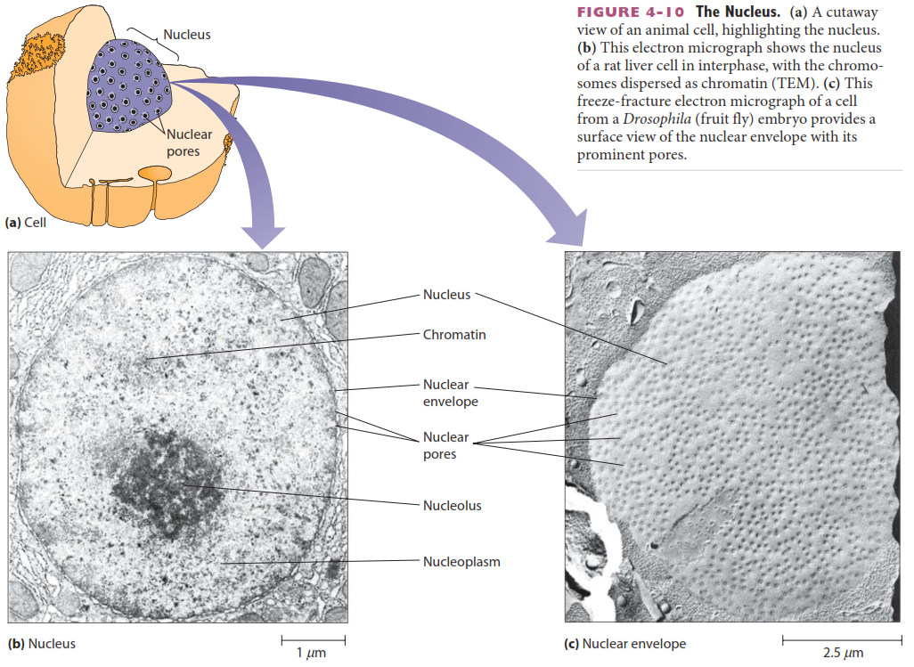

Slide 26
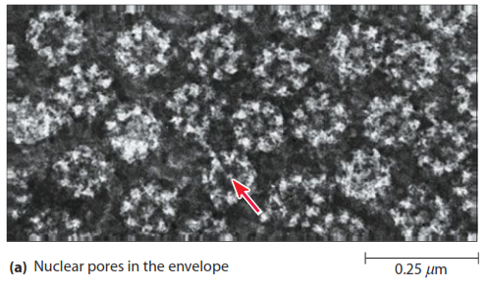
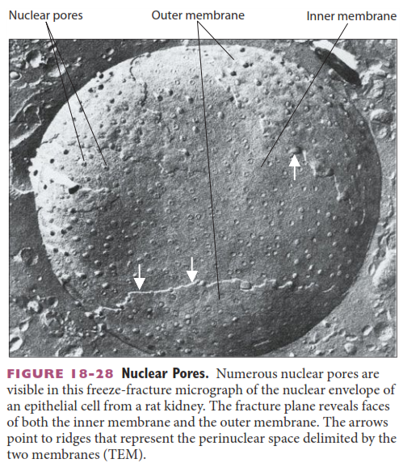
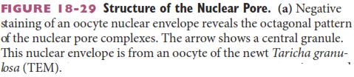

Slide 27
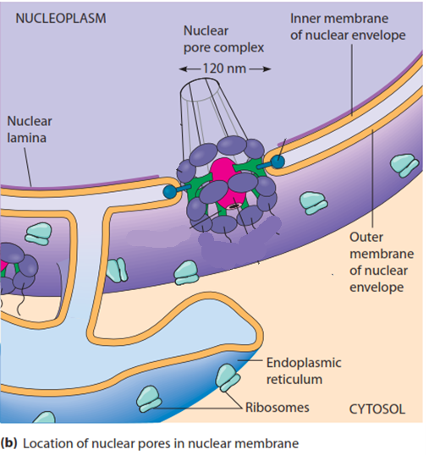
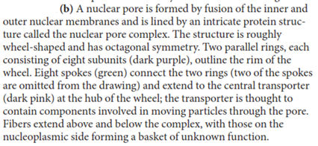
Understand that the nuclear pore is an octameric complex which is a portal between nucleus and cytoplasm
Understand the double membranous nature of the nuclear envelope and that ribosomes also occur on the envelope and that they are continuous with the RER
Also learn anything in the textual description of the nuclear pore slide

Slide 28
Nucleus Function
Essentially contains and isolates the cell's genome from all other elements of the cell
This isolation protects vital a element of the cell—its DNA—from potential contact with reactive and damaging biomolecules generated by other metabolic pathways
particularly pathways that generate
DNA-damaging reactive oxygen species
Nucleus contains proteins/enzymes to maintain nuclear structure, maintain DNA in a compact state in chromosome, repair damaged DNA, and regulate the expression of the genes on the DNA, including polymerases and winding and unwinding enzymes

Slide 29
Anucleate & Multinucleate Cells
Although most cells have a single nucleus
Skeletal muscle cells, osteoclasts (bone-resorbing cells), and some cells in the liver are multinucleated
in the case of skeletal muscle, myocytes fuse their membrane to form a syncytium that optimizes the function of muscle; other cells serve a purpose by being multinucleate
Some cells shed their nuclei with good reason and become anucleate
erythrocytes mature to form a biconcave discoid cell shape in which the cell is packed almost completely with the oxygen-binding protein hemoglobin, and removing the nucleus is necessary
Usually removal of or alterations to the nucleus commit the cell to being short-lived since it cannot make proteins in response to altered environments

Slide 30
Contents of The Nucleus
Chromatin & Chromosomes
Consist of DNA and histones
DNA is coiled around the histones, with additional coiling of the coils
Nucleolus

Slide 31
Nucleolus
Nucleoli from from nucleolar organizer regions within the nucleoplasm: this is DNA which expresses instructions to produce ribosomal RNA (rRNA)
As molecules of rRNA are synthesized, they are combined with proteins to form the two kinds of ribosomal subunits (40S and 60S)
Very metabolically active cells tend to have a large nucleolus, since a large number of ribosomes are demanded
Finished ribosomal subunits (15 nm diameter) exit the nucleus via nuclear pores (9 nm dia.) to the cytoplasm
so must be "squished out"
If cells can make 20,000 subunits/minutes, and they have 3000-4000 pores, that is 5-6 subunits moved out/minute

Slide 32
Nuclear Function & The Cell Cycle
The cell cycle refers to phases in which cells proliferate (duplicate or reproduce themselves)
There are two major periods of the cell cycle:
Interphase
in which the cell grows and carries on its usual activities even if not proliferating
if proliferating it includes phases in which its DNA (genome) is replicated (duplicated) and period before and after the period used for mitosis and cell divison
Mitosis and cell division, in which cells partition replicated DNA (genome) into two daughter cells

Slide 33
Cell Cycle Phases Overview
Cell cycle is composed of several phases:
Interphase
within interphase are three phases in cells that enter if they are proliferating
G₁
S
G₂
M
this is the phase where chromosomes separate and daughter cells form by division of cytoplasm

Slide 34
Cell Cycle Phases Detail
G₁ Phase (gap 1) In this part of interphase
cells are producing (transcribing) abundant amounts of RNA in the nucleus which leaves the nucleus to produce (translate) into proteins
These proteins will be made to add enough cell structural elements to increase its size/volume such that two daughter cells can form with a full complement of the proteins they need
Among the new proteins produced will be histones that will be necessary to complex with newly formed DNA in the daughter cells

Slide 35
Cell Cycle Phases Detail
S Phase In this part of interphase
DNA is duplicated by a replication process that must go to completion (hence the name S phase = synthesis phase)
G₂ phase (gap 2) In this part of interphase
With DNA replication complete, the cell must now start metabolic/biochemical pathways preparing for M phase (mitosis). This would likely include many processes that are also part of G₁ phase, but not processes necessary for S phase.

Slide 36
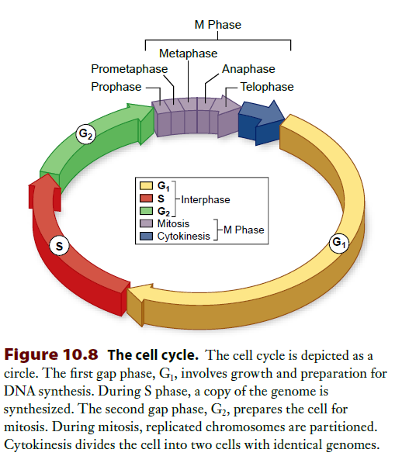
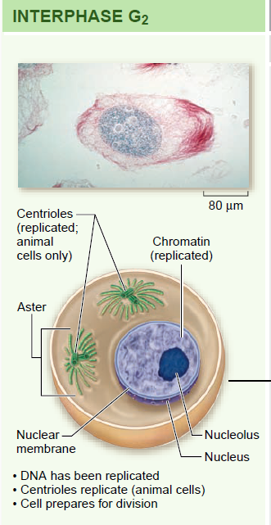

Slide 37
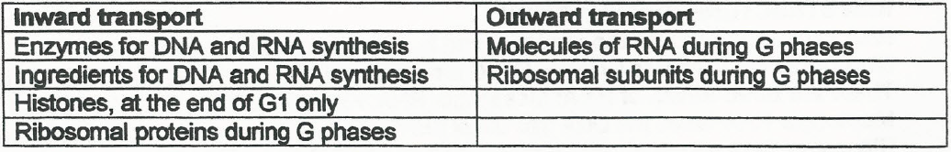
Transport through nuclear pores: During the G phases, many macromolecules enter and leave the nucleus via the pores

Slide 38
Phases in Mitosis & Cell Division
M phase involves the separation of replicated chromosomes (completed in S phase) and division of cytoplasm into daughter cells
M phase is described by its own phases that detail these processes:
prophase: The double-membrane nuclear envelope, the nuclear the cortex, and nucleolus disappear microscopically
metaphase: chromosomes align on a spindle equator with no evidence of a nucleus
anaphase: sister chromatids separate and move toward opposite spindle poles; cytokinesis starts in which a plate forms between separated chromosomes to divide the cytoplasm to daughter cells
telophase: the nuclear membrane, nuclear cortex and nucleolus all reappear in the daughter cells
meiosis goes through two rounds of this prophase→telophase division to produces gametes (ova and sperm) and the details of this and mitosis are addressed in later lectures

Slide 39
Mitotic Activity in Different Cell Types
Cell proliferation is essential for body growth and tissue repair
Cells can be classified 3 ways with respect to their frequency and ability to proliferate (be mitotic)
Labile cells are continually dividing because their numbers are continually depleted by virtue of function
typically epithelial cells: GI tract, respiratory tract, etc.
hematopoeitic cells in bone marrow
Stable cells: are quiescent and divide only when stimulated or depleted from damage
parenchymal cells: liver, kidney, pancreas, etc.
mesenchymal cells: bone, cartilage, fibroblasts
Permanent (postmitotic) cells: have lost the ability to divide so trauma is significant
neurons, skeletal muscle, heart muscle

Slide 40
Reading (Sources)
Becker's WotC: pp 83-84, 422-427, 430-431, 433-435, 442-444, 536-542
Raven: pp 65-69, 75-79, 192-197
Marieb: pp 71-72

